Slide 1
Maths
Multiplication and Division
Year One
Maths | Year 3 | Multiplication and Division | Multiplication | Lesson 4 of 4: Short Multiplication

Slide 2
Short Multiplication
 | 6 | 6
× |  | 4
2 | 6 | 4
 | 2

Slide 3
Aim
I can solve multiplication problems using short multiplication.
Success Criteria
I can set my calculation out correctly in columns.
I can start at the right hand side when calculating.
I check my answers using another method.

Slide 4
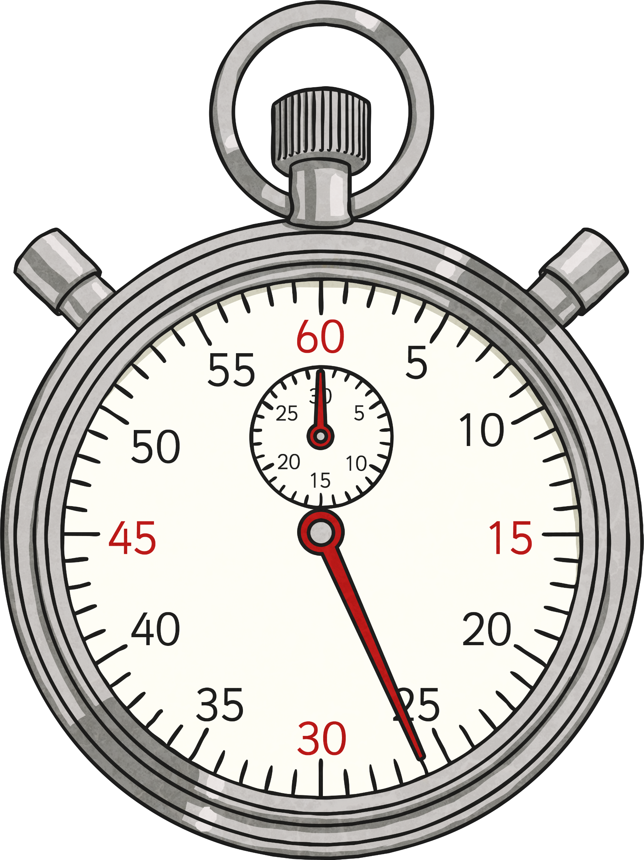
Beat the Clock
Your teacher will tell you which columns to complete. The stopwatch will stop after 5 minutes.
If you finish before the clock, shout ‘finished!’ and your teacher will tell you your time. Write this at the top of the sheet.
When your work is marked your teacher will give you a score.
If you didn’t get all the questions right, next time focus on improving your score.
If you got them all correct - well done! Next time try to improve your time or choose a more tricky multiplication table.
Remember that you are racing against yourself. Don’t worry about what your friends are doing!

Slide 5
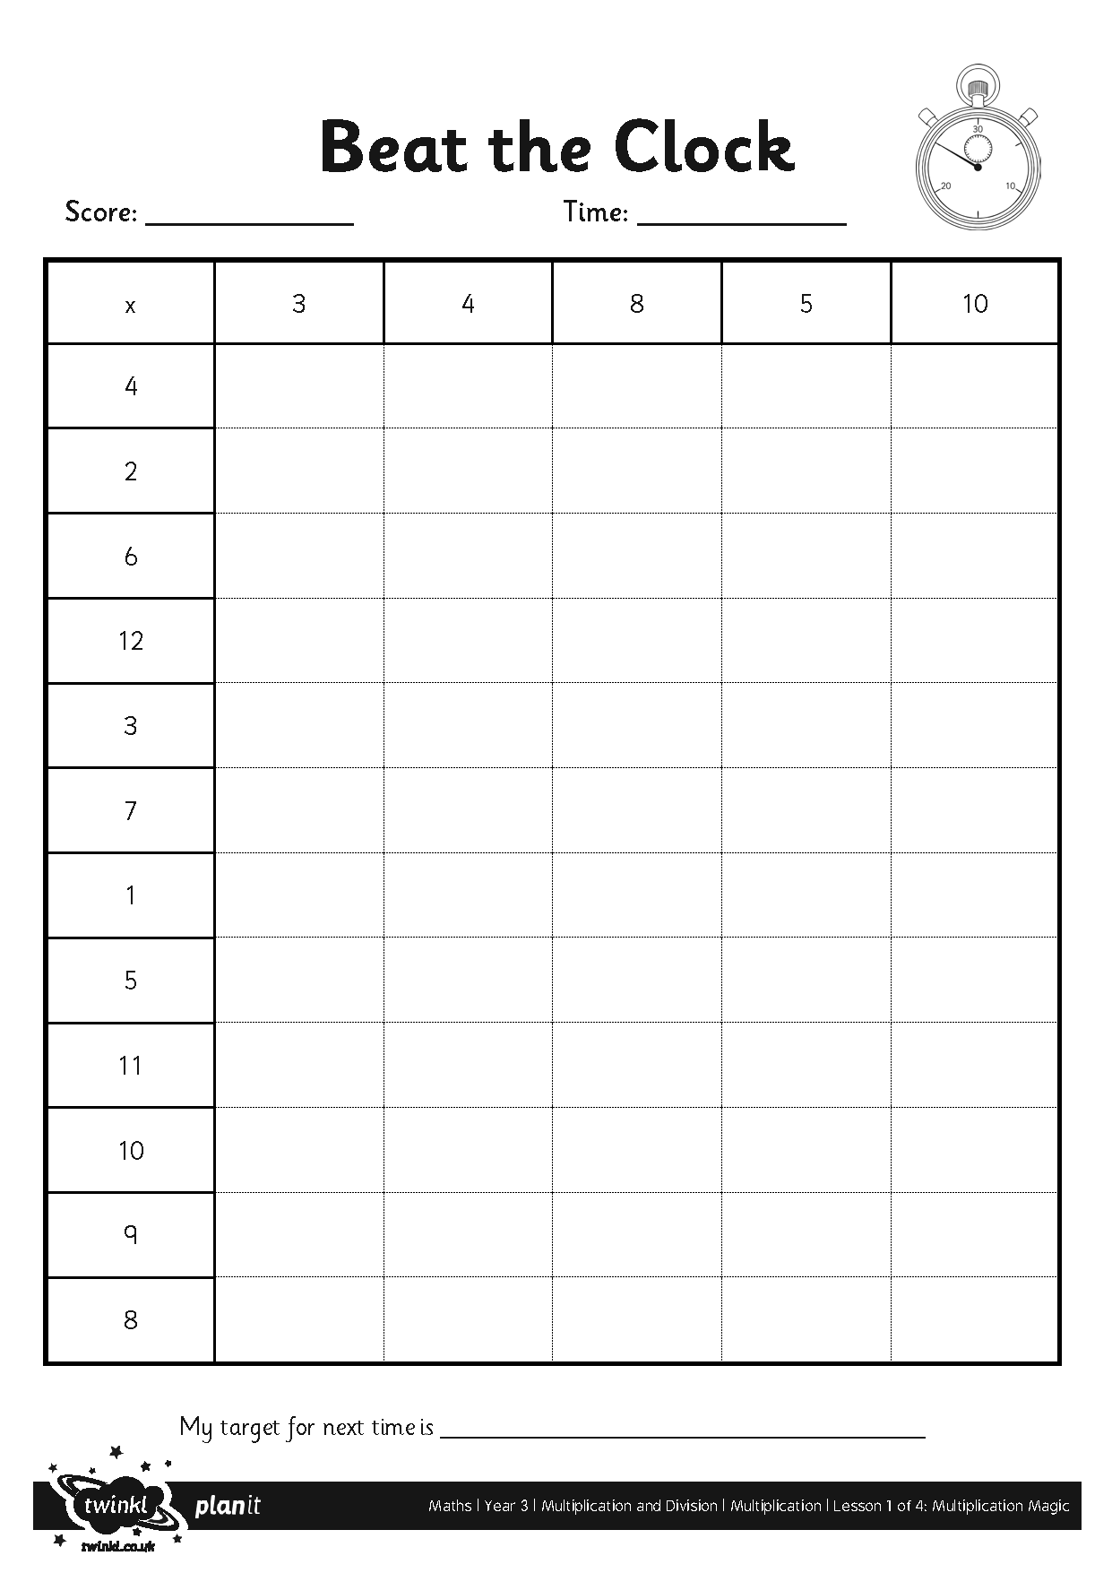
Beat the Clock

Slide 6
Short Multiplication
Use place value counters or base ten blocks to calculate the answer.
T
O
 | 5 | 6
× |  | 4
Hundreds | Tens | Ones
100
100
10
10
10
10
1
1
1
1
1
1
1
1
1
1
100
100
10
10
10
10
1
1
1
1
1
1
1
1
1
1
2
2
4
100
100
1
1
1
1
1
10
10
10
10
1
1
1
1
1
100
100
10
10
2

Slide 7
Short Multiplication
T
O
First set your calculation out correctly with one number in each square. Use a ruler to draw the lines.
 | 5 | 6
× |  | 4
2 | 2 | 4
 | 2
Multiply the ones digit by 4. 6 × 4 = 24.
Write the 2 tens in the tens column under the line. You need to carry this over to the tens column because it represents 20.
Now calculate the tens. Multiply 5 by 4. 5 × 4 = 20.
Don’t forget to add on the 2 tens that you carried. 20 + 2 = 22.

Slide 8
Short Multiplication
T
O
Always remember to think about your answer and check it if you’re not sure it looks correct.
 | 5 | 6
× |  | 4
2 | 2 | 4
 | 2
You might be able to check it mentally or you could use the grid method or expanded method.
56 × 4
50 × 4 = 200 (Use Multiplication Magic)
6 × 4 = 24 (Use times tables knowledge)
200 + 24 = 224

Slide 9
Your Turn Now
45 × 3 =
89 × 4 =
8 × 72 =
How will you set the third problem out?
Remember that 8 × 72 is the same as 72 × 8.

Slide 10
Answers
T
O
T
O
T
O
 | 4 | 5
× |  | 3
1 | 3 | 5
 | 1
 | 8 | 9
× |  | 4
3 | 5 | 6
 | 3
 | 7 | 2
× |  | 8
5 | 7 | 6
 | 1
45 × 3 = 135
89 × 4 = 356
8 × 72 = 576

Slide 11
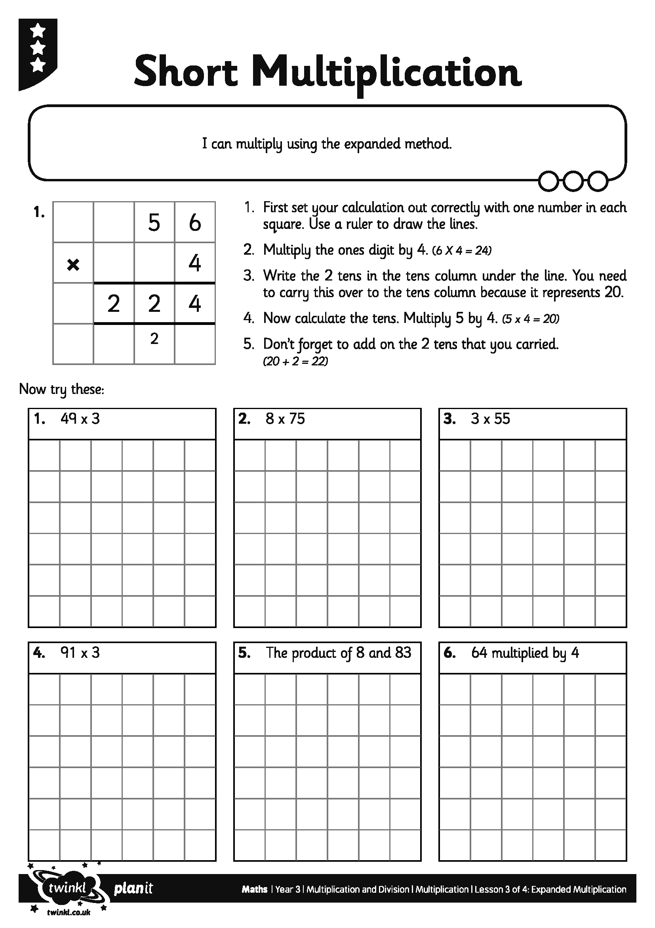
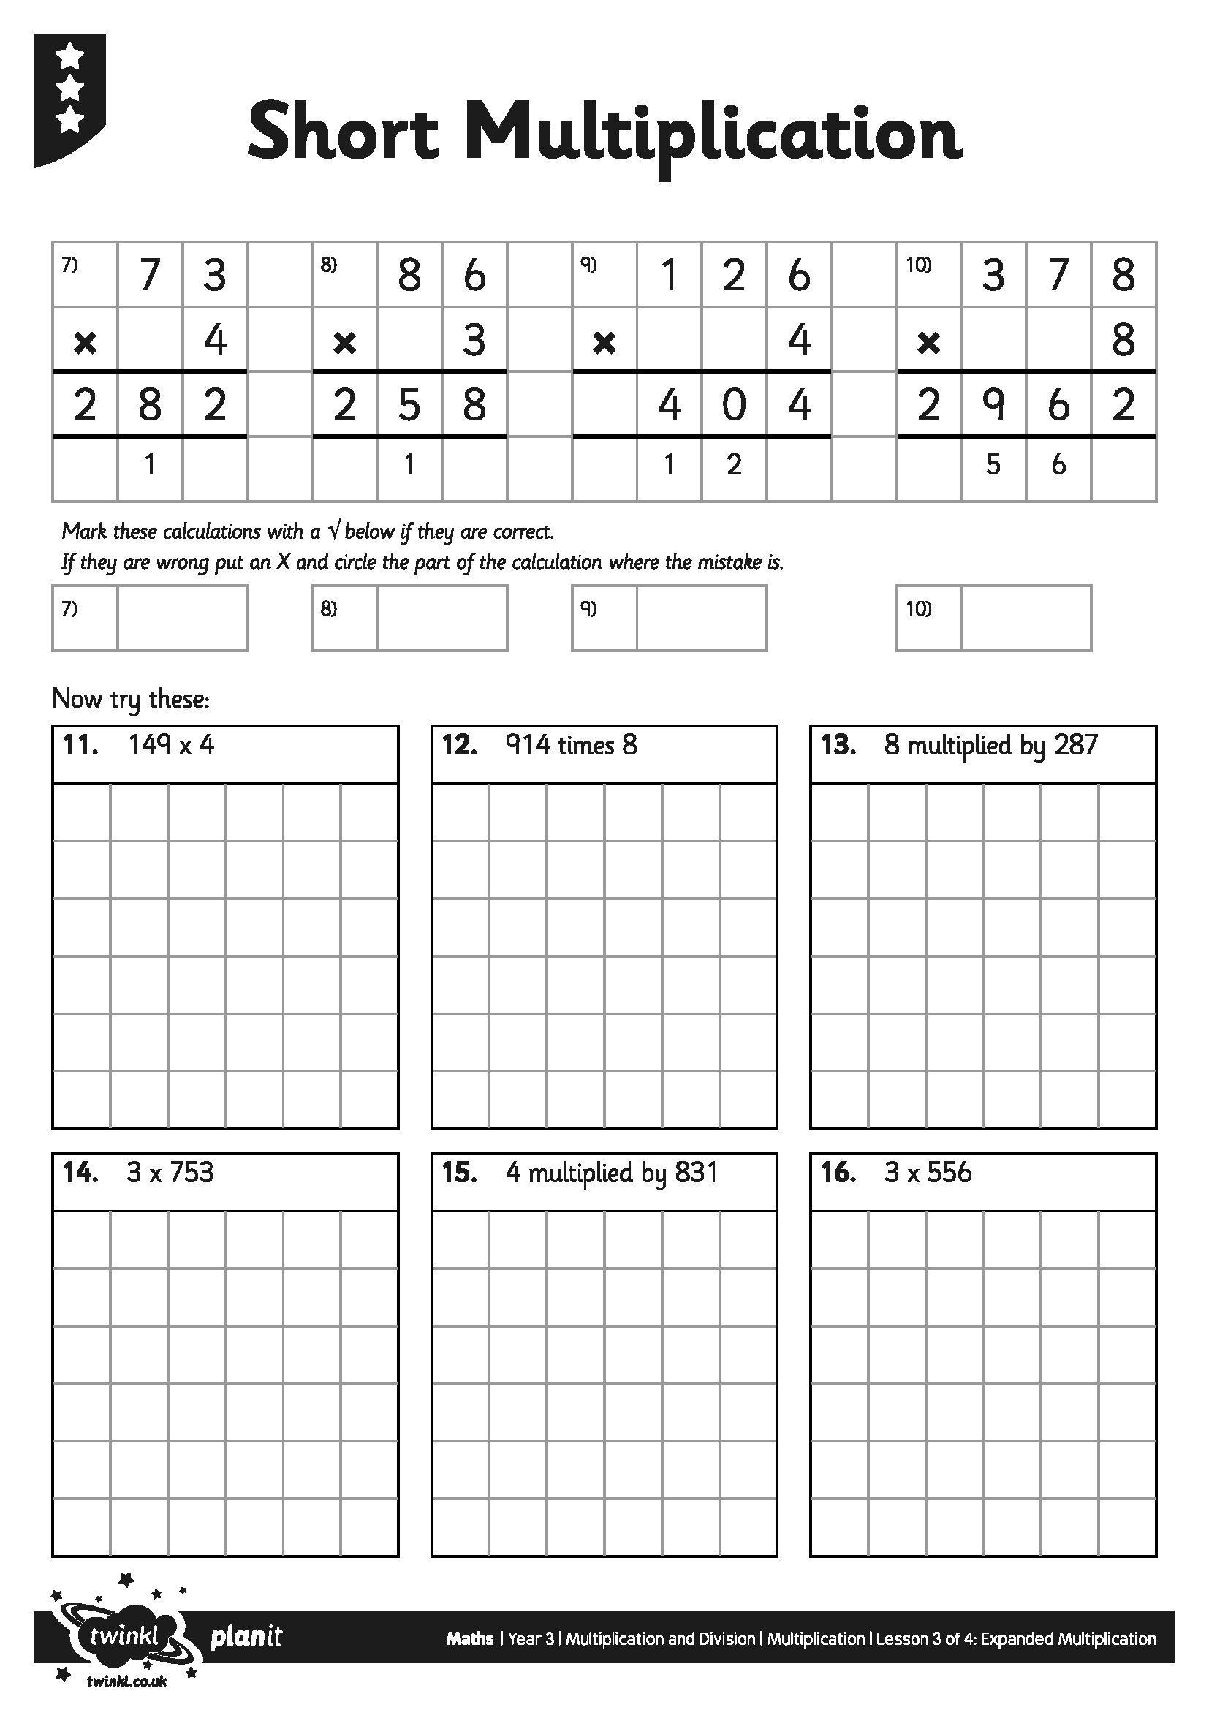
Multiplication Activities

Slide 12
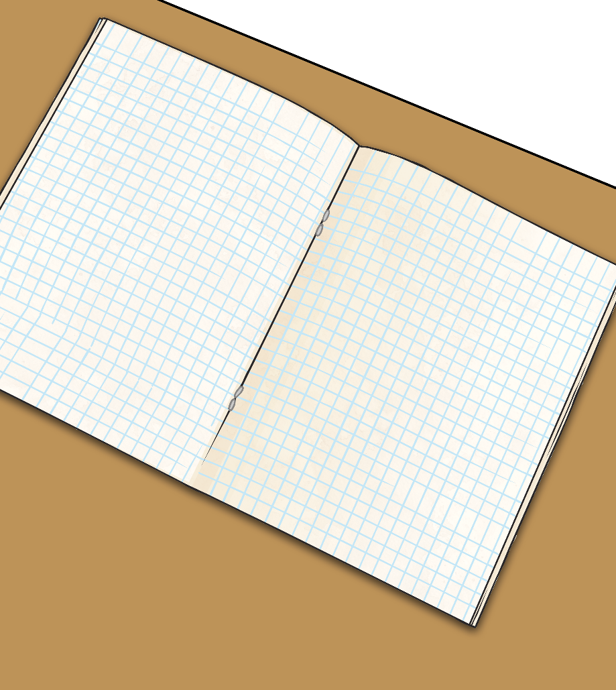
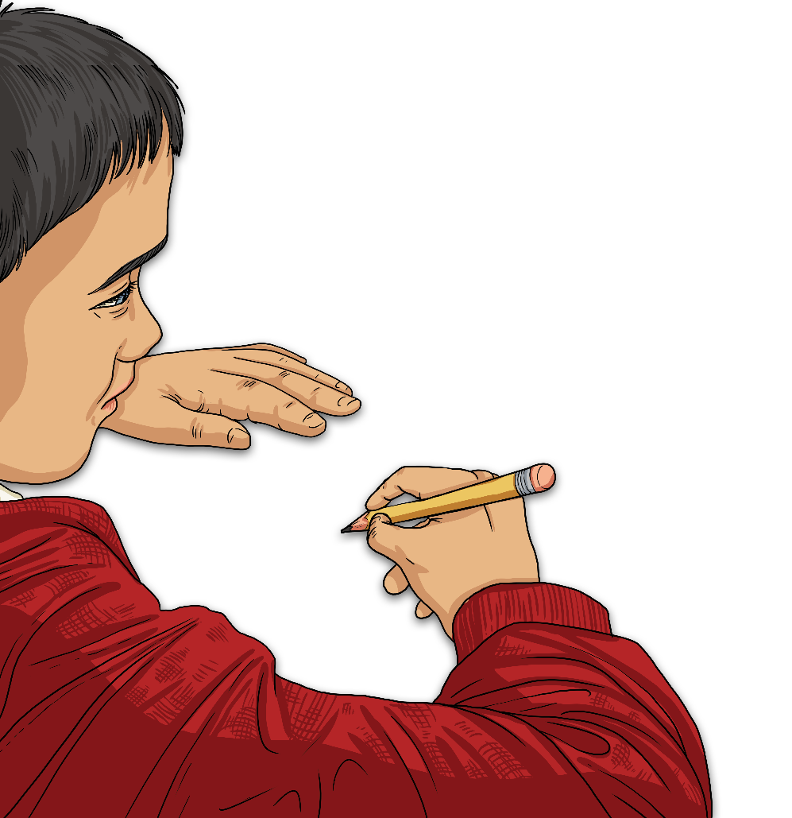
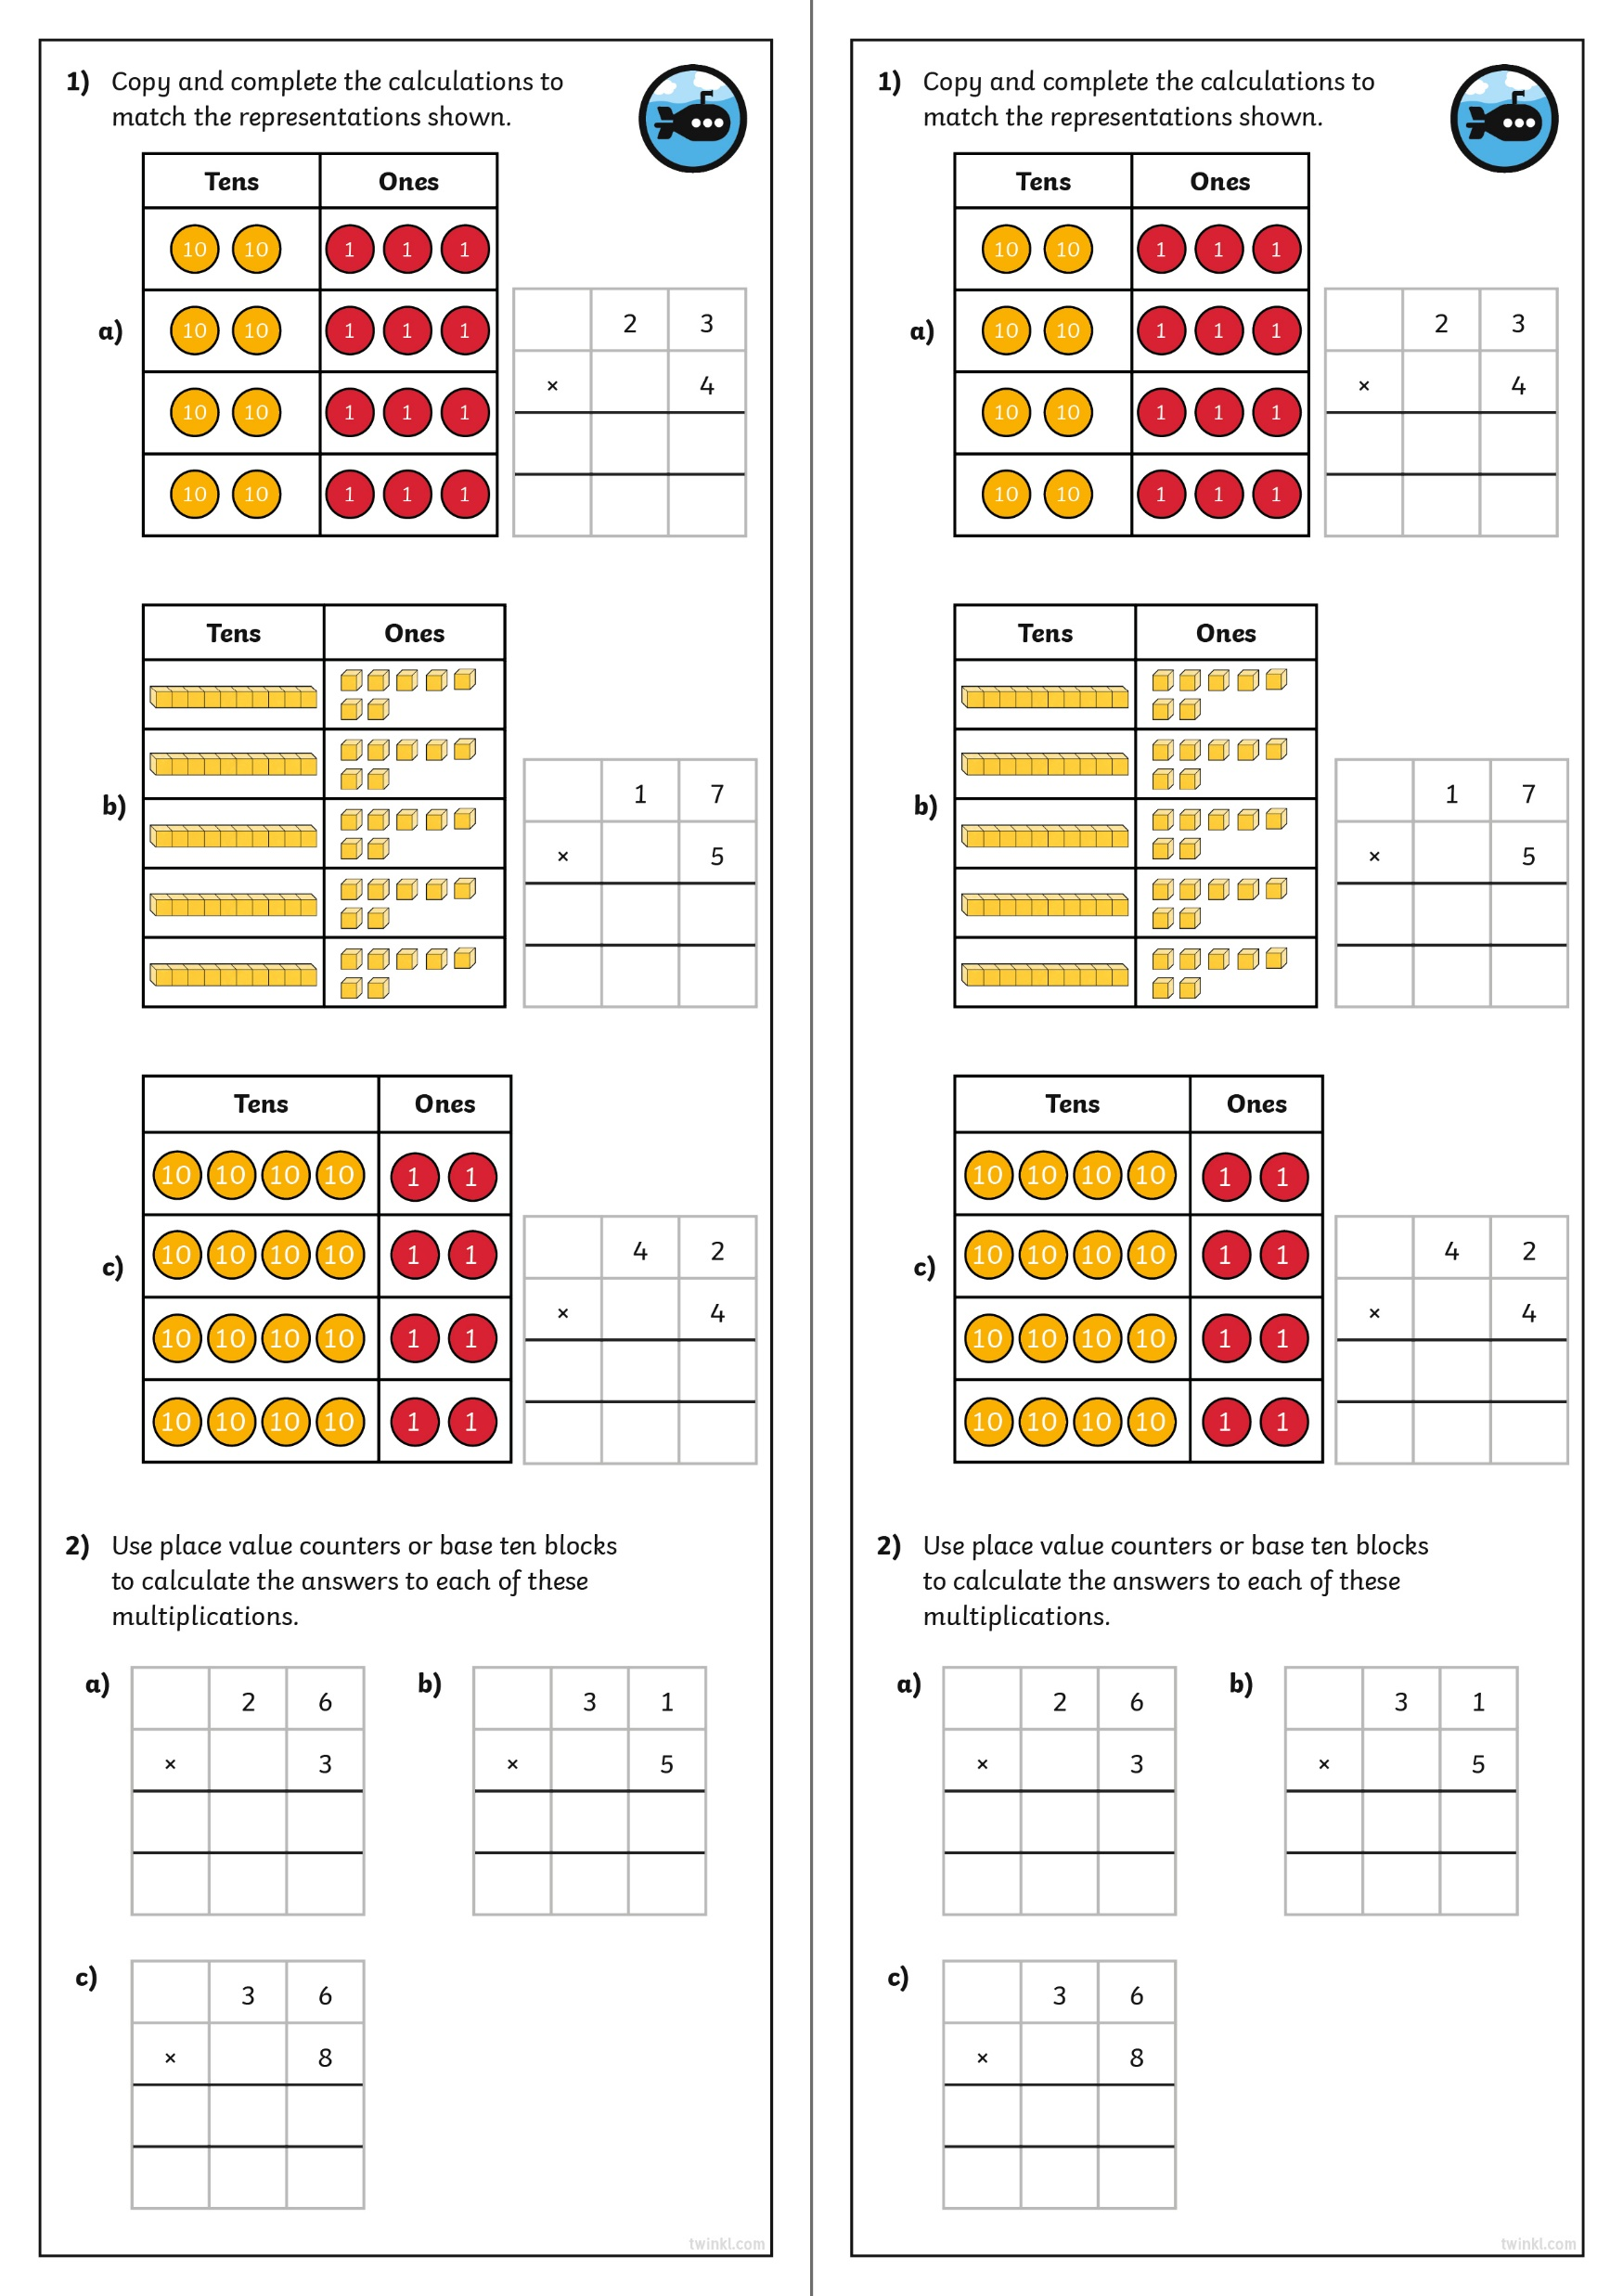
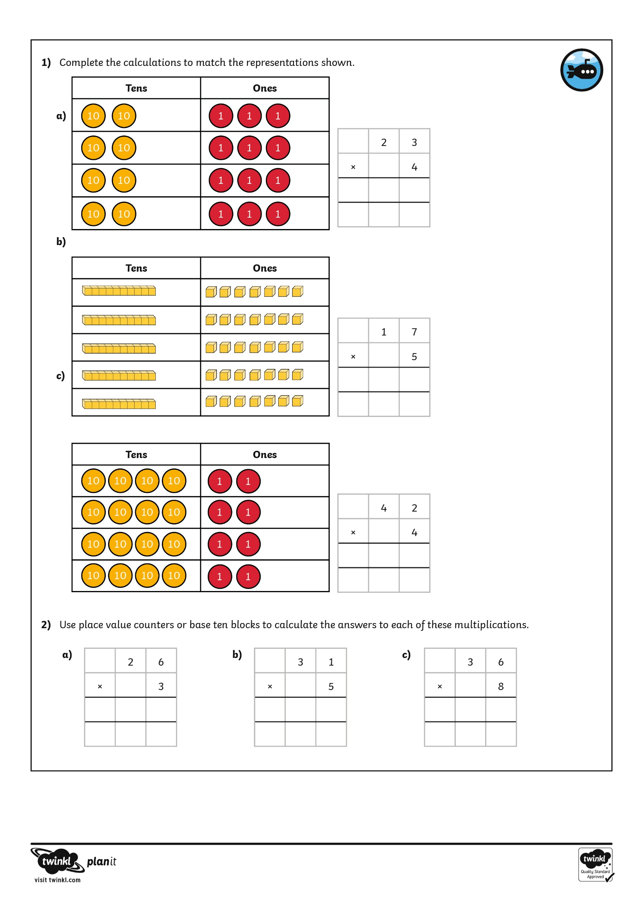
Diving into Mastery
Dive in by completing your own activity!

Slide 13
Check Your Answers
How could we check our calculations?
Do we know any other calculation methods for multiplication?
With a partner use the grid method to check your answers.
If you made a mistake try to find where you went wrong, highlight your error and correct the calculation.
+

Slide 14
Aim
I can solve multiplication problems using short multiplication.
Success Criteria
I can set my calculation out correctly in columns.
I can start at the right hand side when calculating.
I check my answers using another method.

