Slide 1
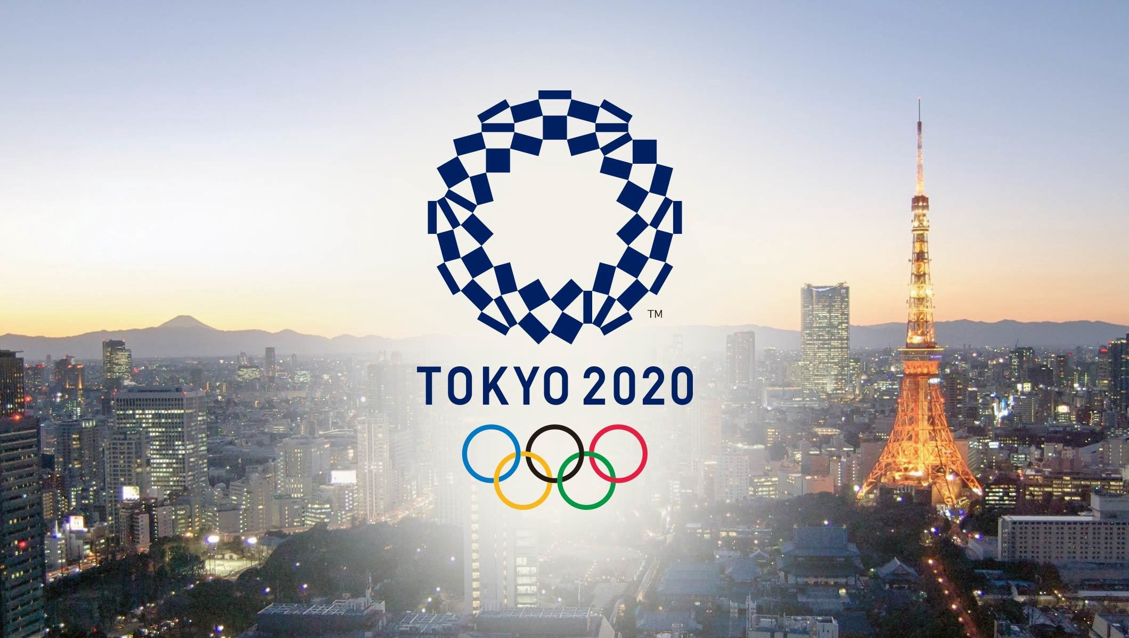
Olympic Games 2020 Tokyo
New Tokyo 2020 Olympic dates will be 23 July to 8 August 2021 due to Covid-19
Venues and capacities

Slide 2
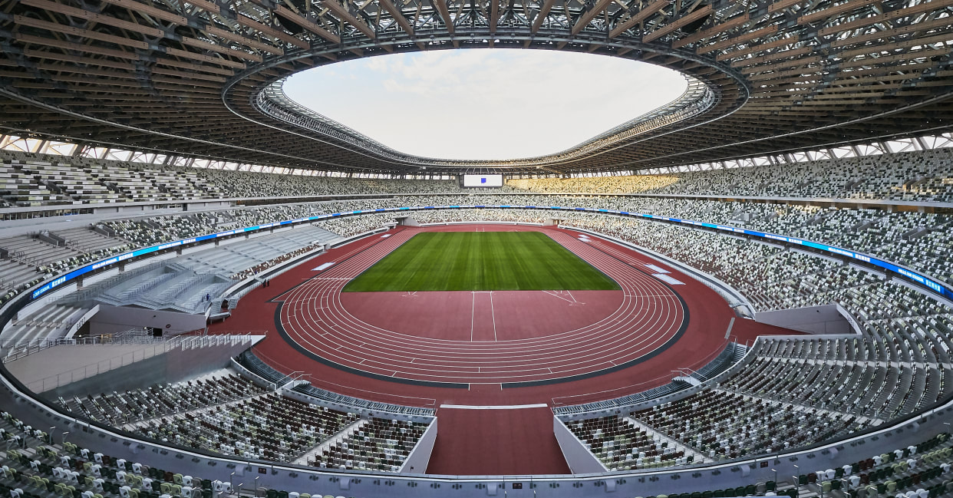
Olympic Stadium
Capacity: 68000
Olympic Opening and Closing Ceremonies
The National Stadium was used as the main stadium for the Tokyo 1964 Olympic Games, and is currently being rebuilt as a brand new stadium for the Tokyo 2020 Games. The Opening and Closing ceremonies of the Tokyo 2020 Games will be held here along with athletics events and football matches. After the 2020 Games are over, the stadium will be used for sporting and cultural events.

Slide 3
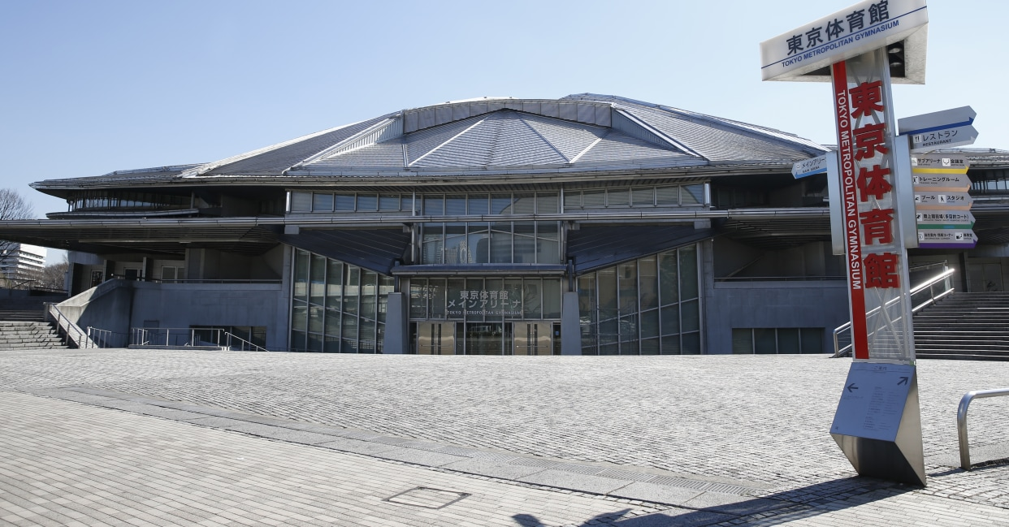
Tokyo Metropolitan Gymnasium
Capacity: 7000
tokyo Metropolitan Gymnasium is one of the legacy venues of the 1964 Olympic Games. It served as the main arena for Tokyo 1964, hosting the gymnastics events and water polo, which was held in the venue's indoor pool.

Slide 4
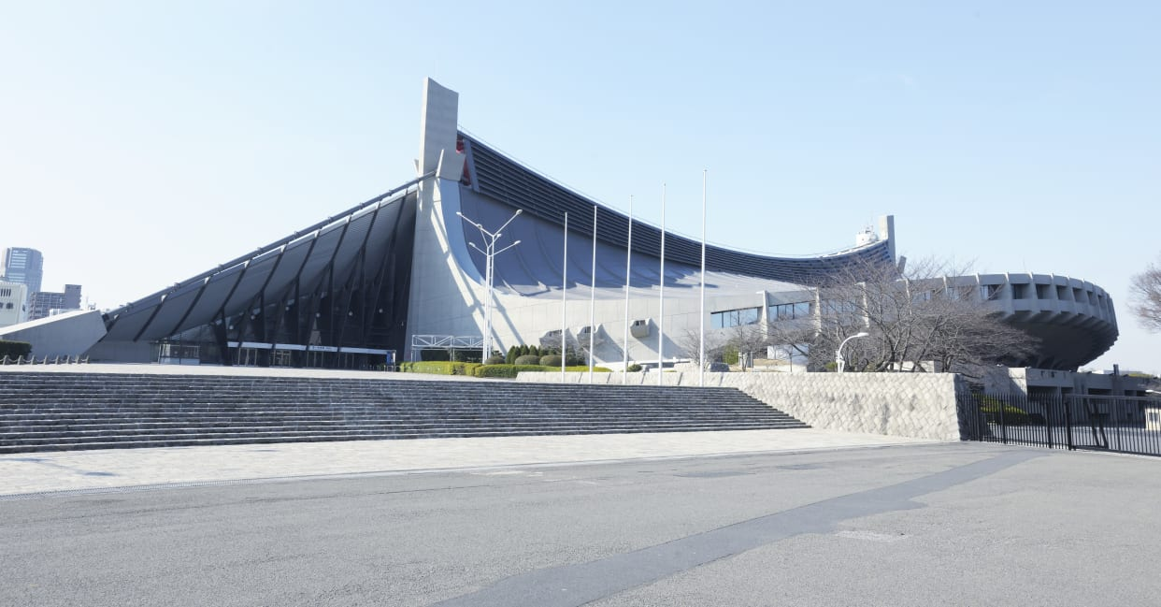
Yoyogi National Stadium
Capacity: 10200
Yoyogi National Stadium was constructed to stage the aquatics and basketball competitions for the Tokyo 1964 Games. The arena is famous for its suspension roof design, and has earned a glowing international reputation.

Slide 5
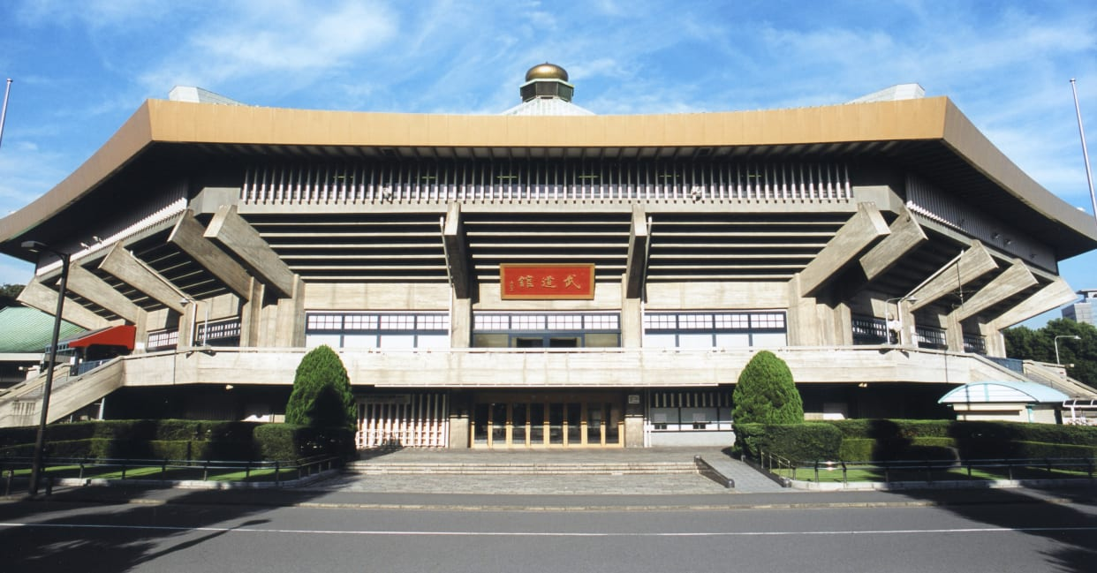
Nippon Budokan
Capacity: 11000
The Nippon Budokan is known as the spiritual home of Japanese martial arts especially judo. At the 1964 Games, judo made its debut as an Olympic sport, with competitions being held here.

Slide 6
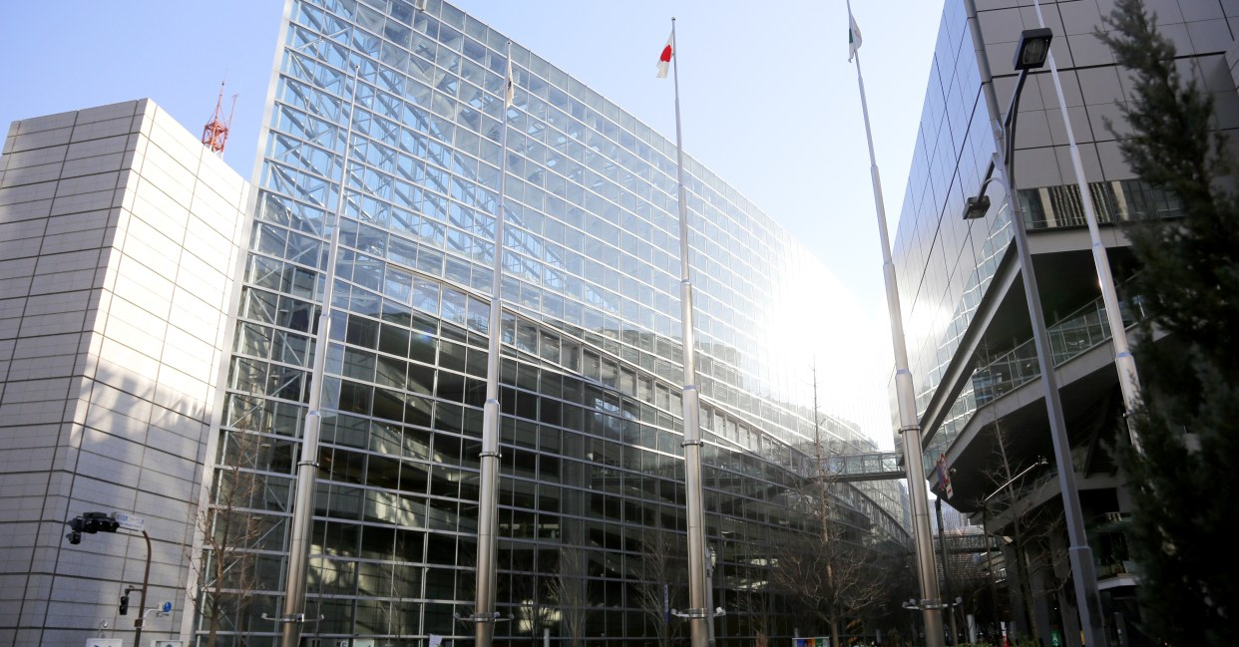
Tokyo International Forum
Capacity: 5000
the Tokyo International Forum is a multi-purpose exhibition centre comprised of eight main halls of various sizes, exhibition spaces and other facilities. The structure features swooping curves of steel and glass, with an exterior design resembling an elongated boat.

Slide 7
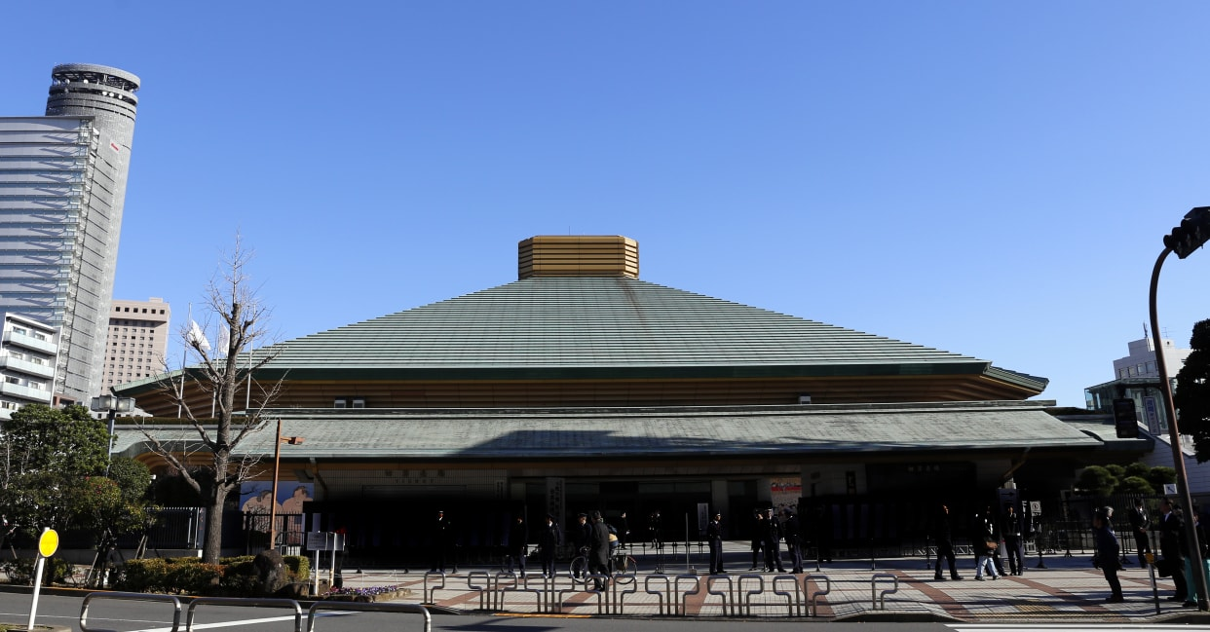
Kokugikan Arena
Capacity: 7300
Kokugikan Arena is the spiritual home of the Japanese national sport of sumo wrestling. The interior is designed in a bowl shape to allow spectators to easily view the sumo bouts in the centre of the auditorium from wherever they are seated.

