Slide 1
The Desert Biome
By Cameron

Slide 2
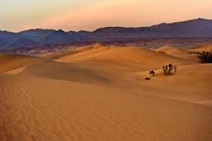
Introduction.
A desert is a place that does not have much rainfall. So Antarctica is actually a desert! The Sahara desert is the largest hot desert. As there is not much rain deserts are very dry and not many plants live there

Slide 3
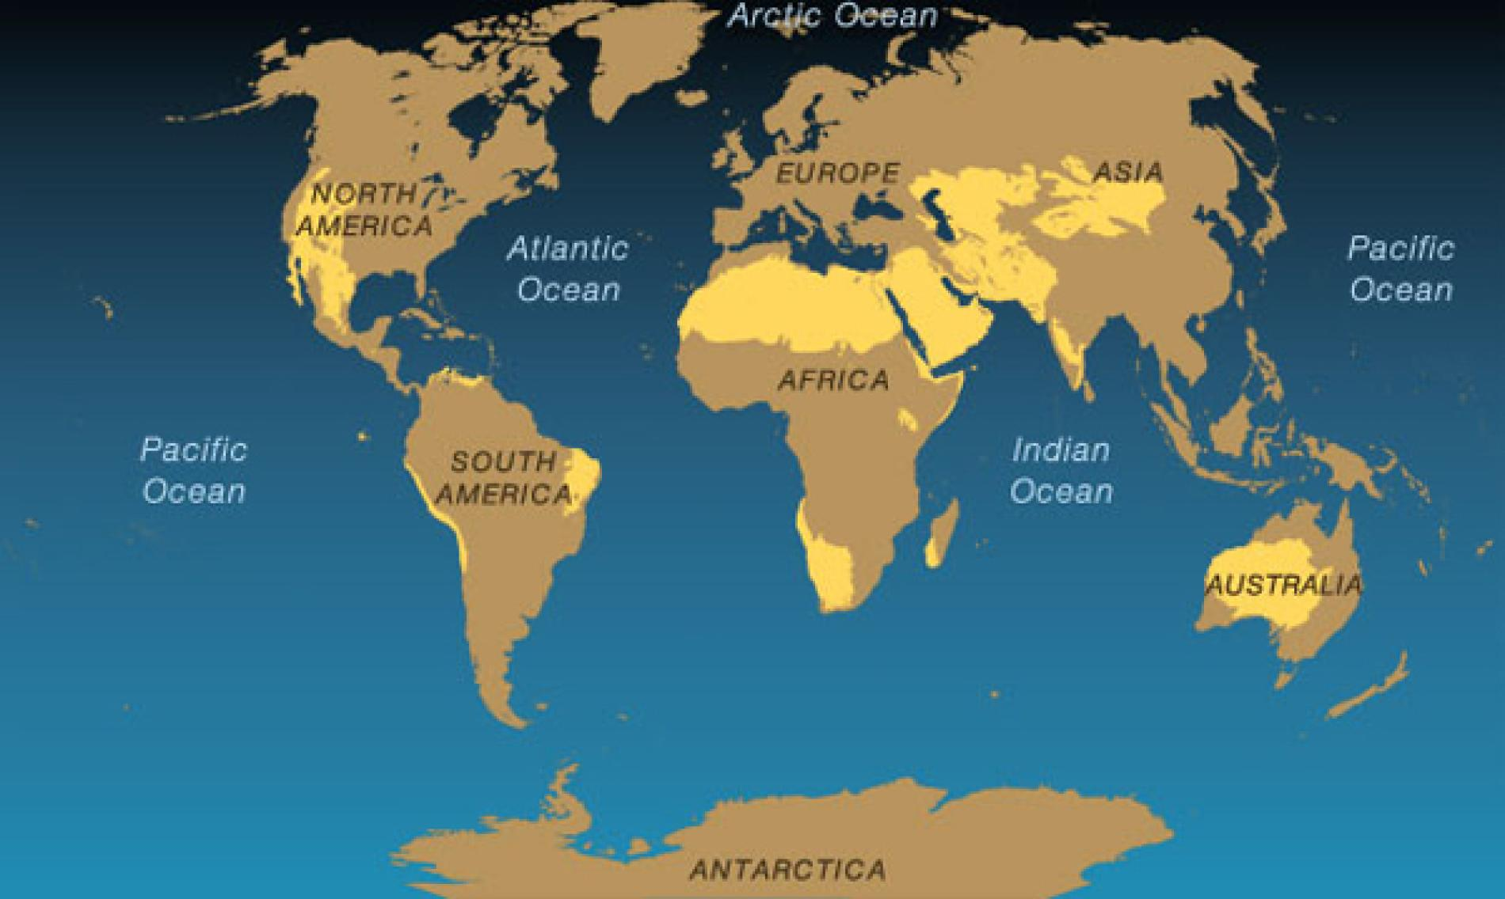
About the desert.
The average temperature is 100f,25cm of water falls on average a year, hot and dry deserts are warm throughout the fall and spring seasons and very hot during the summer. the winters usually have very little if any rainfall. Cold deserts have quite a bit of snow during winter. The summer and the beginning of the spring are barely warm enough for a few lichens, grasses and mosses to grow. Deserts are found mainly in Africa and Australia.

Slide 4
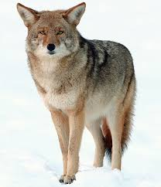
Animals found in the desert
Scorpions and spiders
Snakes
Camels
Meerkats
Coyotes
Tortiose
A Coyote

Slide 5
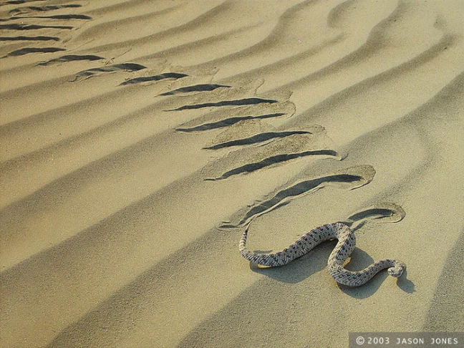
An animal that has adapted to the desert
The Mojave Desert sidewinder in the southwestern United States and the Namib Desert viper in Africa have adapted to slither sideways along the sand not only does it make moving easier on the sand but it makes only two points of the body touch the hot sand. Here is a link to a video of it.

Slide 6
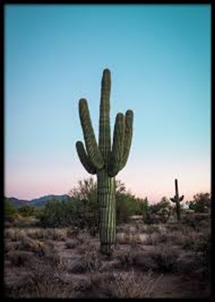
Plants in the desert
Cacti
A small amount of grass
Lots of shrubs
Also lots of bushes
A few wild flowers
A cactus

Slide 7
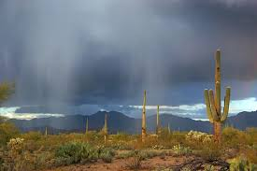
A plant that has adapted to the desert
Cacti, they need barely any water as it only rains 20cm a year.

Slide 8
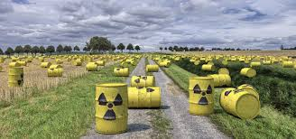
Threats to the desert.
Sometimes nuclear waste is dumped in the desert.

Slide 9
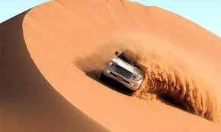
Why you would want to visit this biome is because there are many interesting plants and animals, it could make a very interesting safari. Deserts are generally not inhabited by humans so if you wanted to go somewhere away from people the desert would be a good place

Slide 10
Thank you for watching!

